Slide 1
Inspection of Cast Products
Deep Learning Project

Slide 2
Agenda
1. Project Goal
2: EDA
3. Image Classification
4: Image Anomaly Detection and Localization

Slide 3
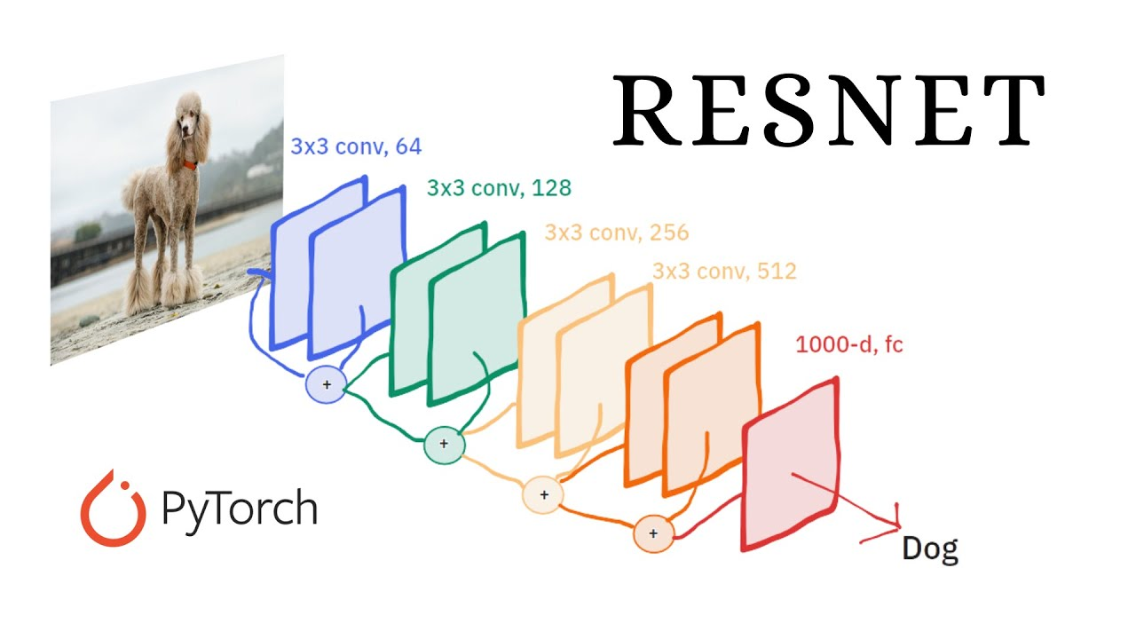
Project Goal: image classification
Compare Shallow and Deep Networks for Classification
Objective: To classify product defects using different network architectures.
Method:
Implemented a CNN-based ResNet model using PyTorch.
Experimented with various versions of ResNet models to compare performance..

Slide 4
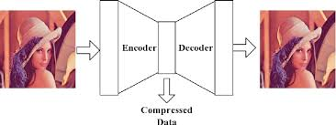
Project Goal: Image Anomaly Detection and Localization
Objective: To locate defect areas in products using unsupervised learning.
Method:
Developed multiple models including:
Convolutional Autoencoder(CAE)
Variational Autoencoder (VAE)
Attention-based Convolutional Autoencoder (ATT_CAE)
Applied these models to identify and locate defects in product images.

Slide 5
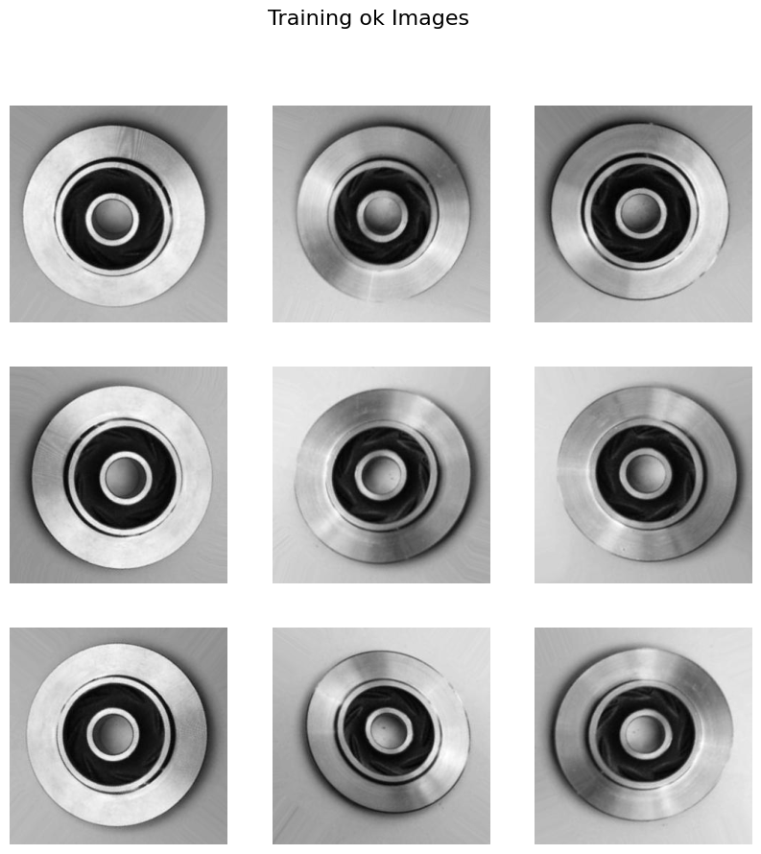
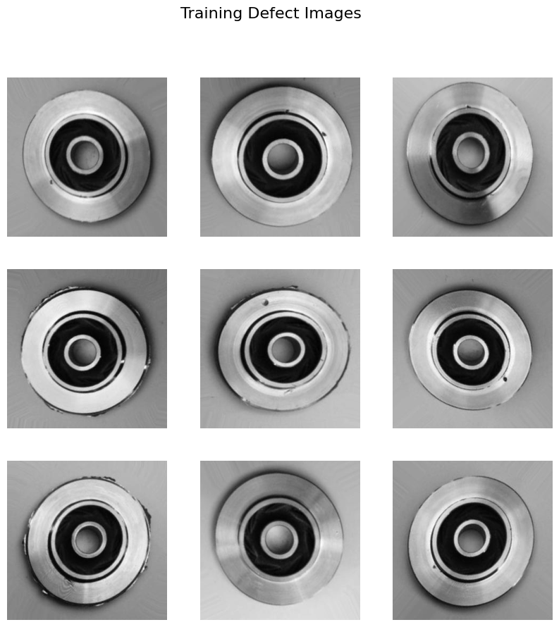
EDA
Training Data Data shape: (6633, 300, 300)
Def: 3758
Ok : 2875

Slide 6
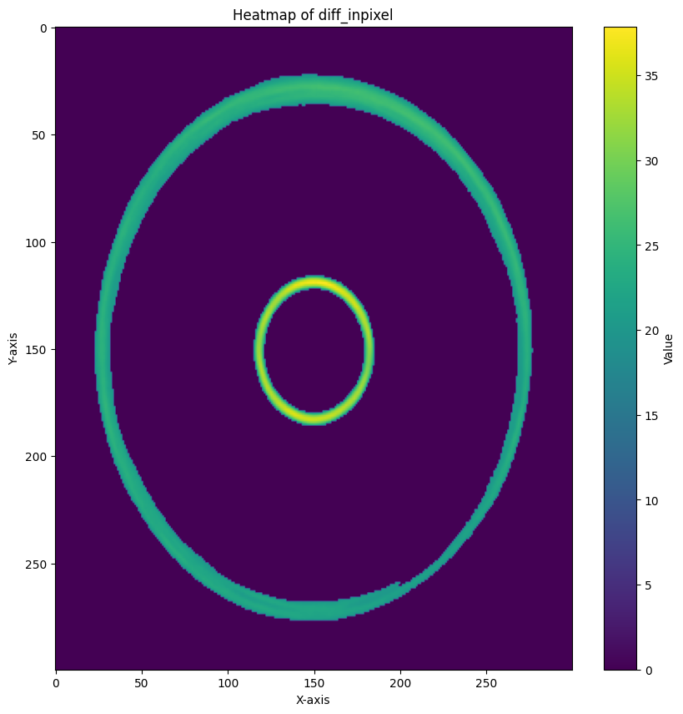
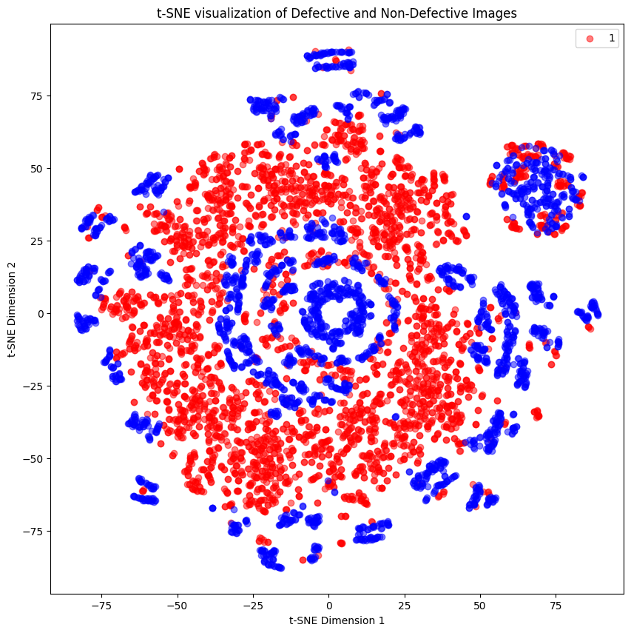
EDA
<-
Most likely defective part
->
Pixel Reduction 2D
Distribution

Slide 7
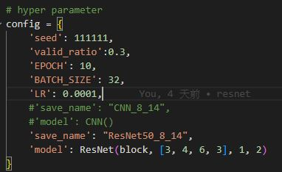
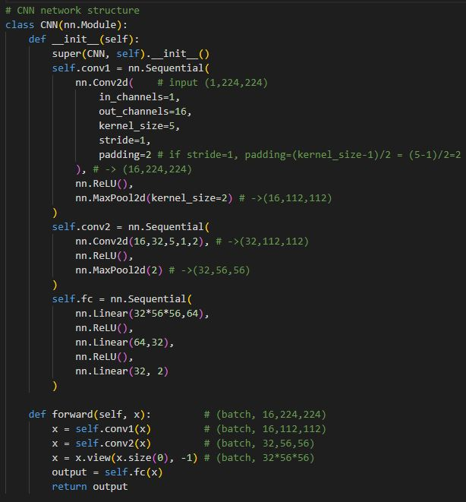
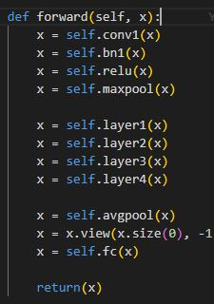
Image Classification
CNN
ResNet
Layers Block:
50: [3, 4, 6, 3]
101: [3, 4, 23, 3]
https://arxiv.org/pdf/1512.03385

Slide 8
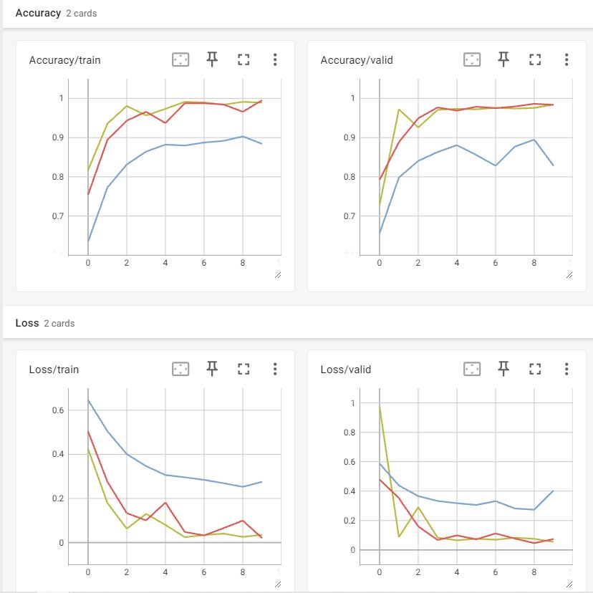
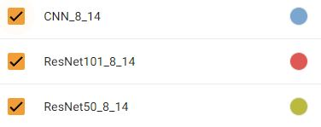
Image Classification
Classify Task:
Test Set Accuracy
CNN | ResNet50 | ResNet101
81.40% | 98.60% | 98.60%

Slide 9
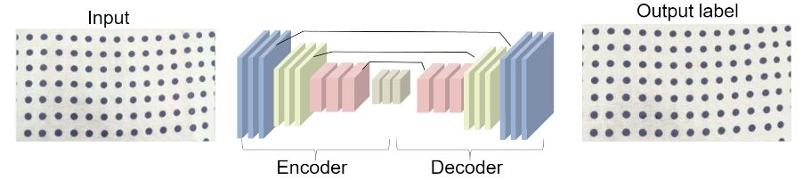
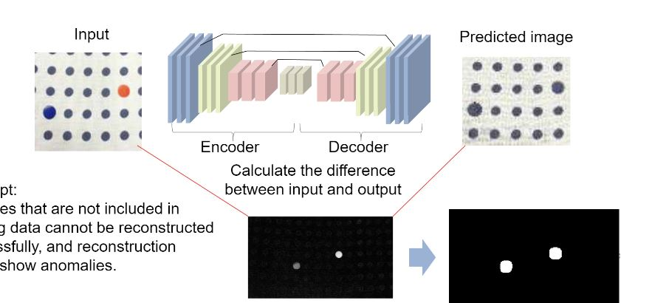
Image Anomaly Detection and Localization
https://doi.org/10.1016/j.ymssp.2021.108723
Train Model
3 Network structure:
- CAE - VAE
- Attention CAE
Image anomaly detection and localization
Notes:
1. 变分自编码器（Variational Autoencoder, VAE）
特点：VAE是一种生成模型，可以学习数据的潜在分布。相比于传统的自编码器，VAE通过引入概率分布来生成潜在空间的表示，这使得它对数据的生成和重建有更强的能力。
应用：VAE可以生成更逼真的图像，从而更好地捕捉图像中的细微特征。这在缺陷检测中可能会有帮助，特别是当缺陷非常小或微妙时。
2. 卷积自编码器（Convolutional Autoencoder, CAE）
特点：CAE使用卷积层代替全连接层来处理图像数据，保留了空间信息，并能更好地提取图像的局部特征。
应用：对于图像数据来说，CAE比传统的自编码器更加高效和有效，特别是在处理高分辨率图像和复杂的缺陷模式时。
4. 注意力机制（Attention Mechanism）与自编码器的结合
特点：在自编码器中引入注意力机制，使模型能够自动关注图像中的关键区域或特定特征。
应用：注意力机制可以帮助模型更好地定位和区分缺陷区域，尤其是在背景复杂或缺陷不明显的情况下。

Slide 10
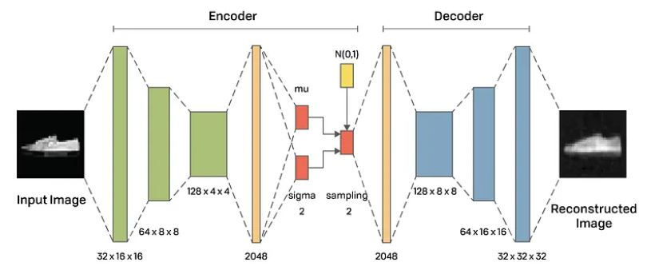
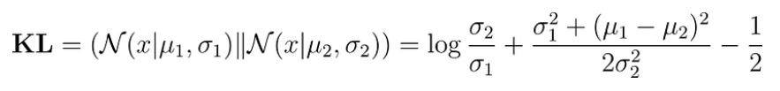
Deep Learning Example
https://avandekleut.github.io/vae/
Detection Task:
VAE
Convolution blocks
Convolution blocks
Loss function: W1 * MSE + W2 * KL

Slide 11
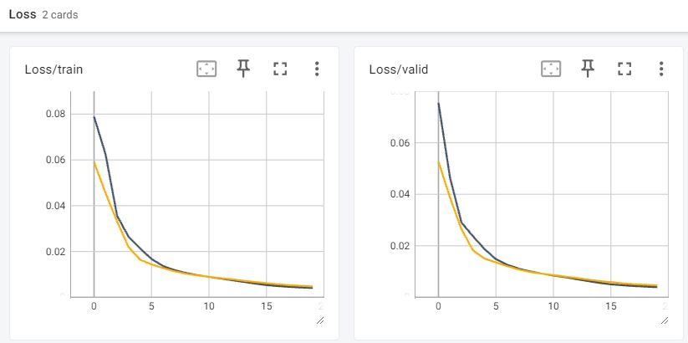
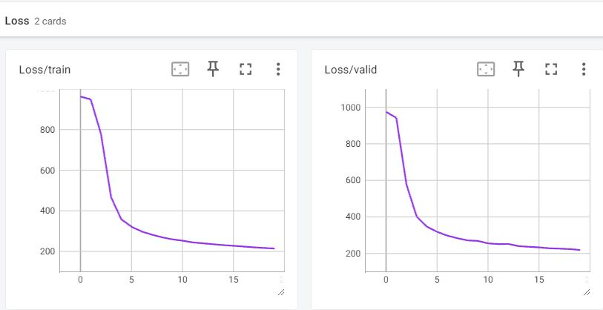
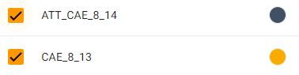

Image Anomaly Detection and Localization

Slide 12
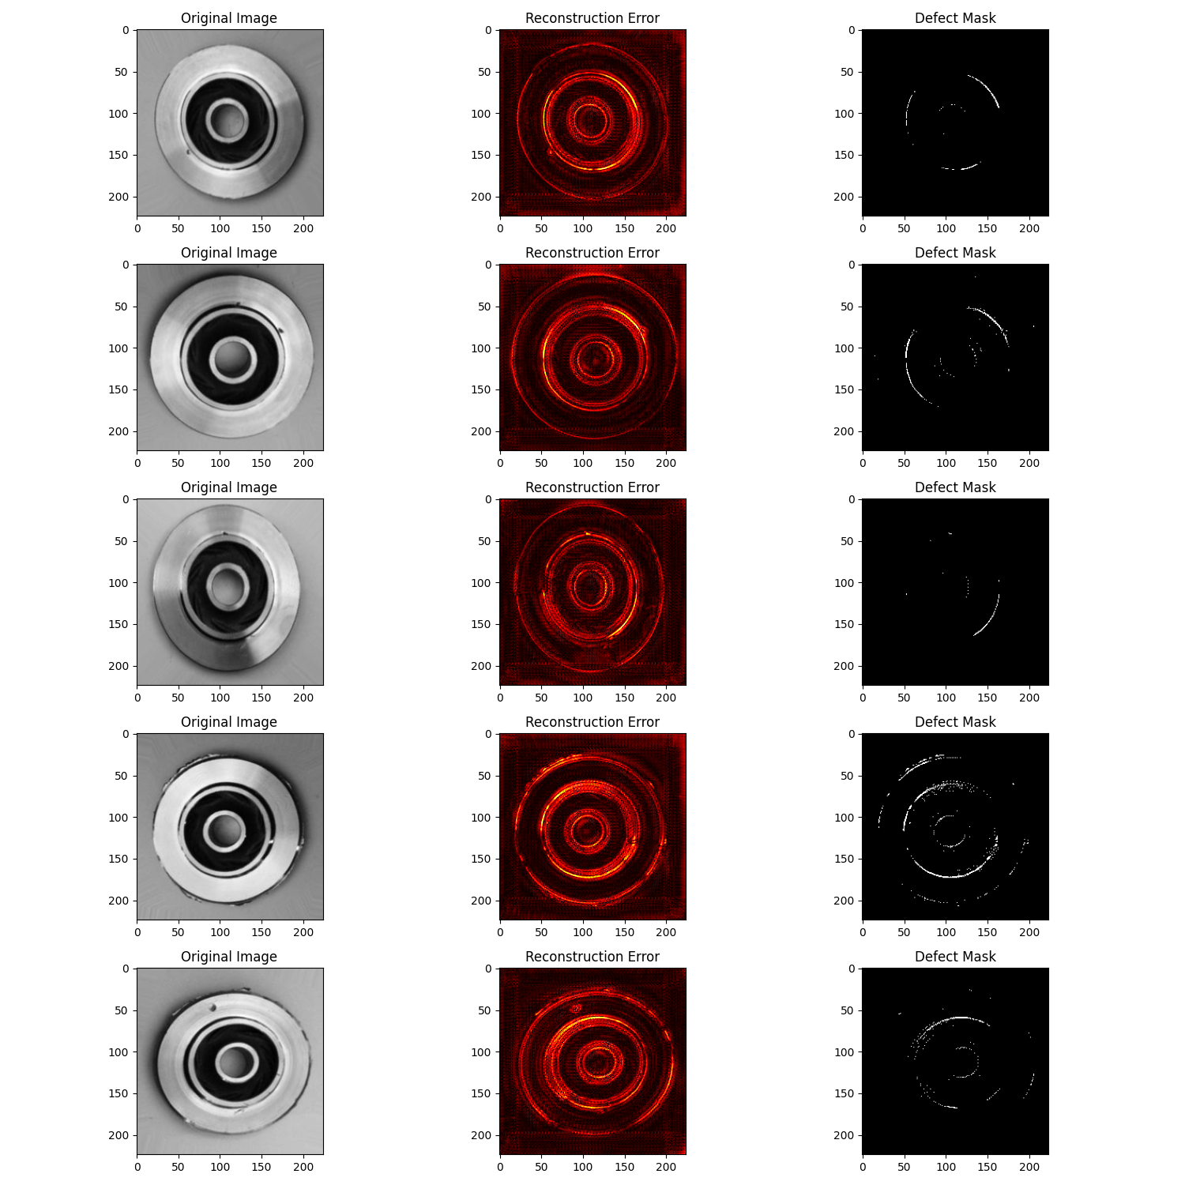
Reconstruction_Error:
Abs( input - output )
Defect_Mask:
Reconstruction_Error > threshold (0.3)
CAE

Slide 13
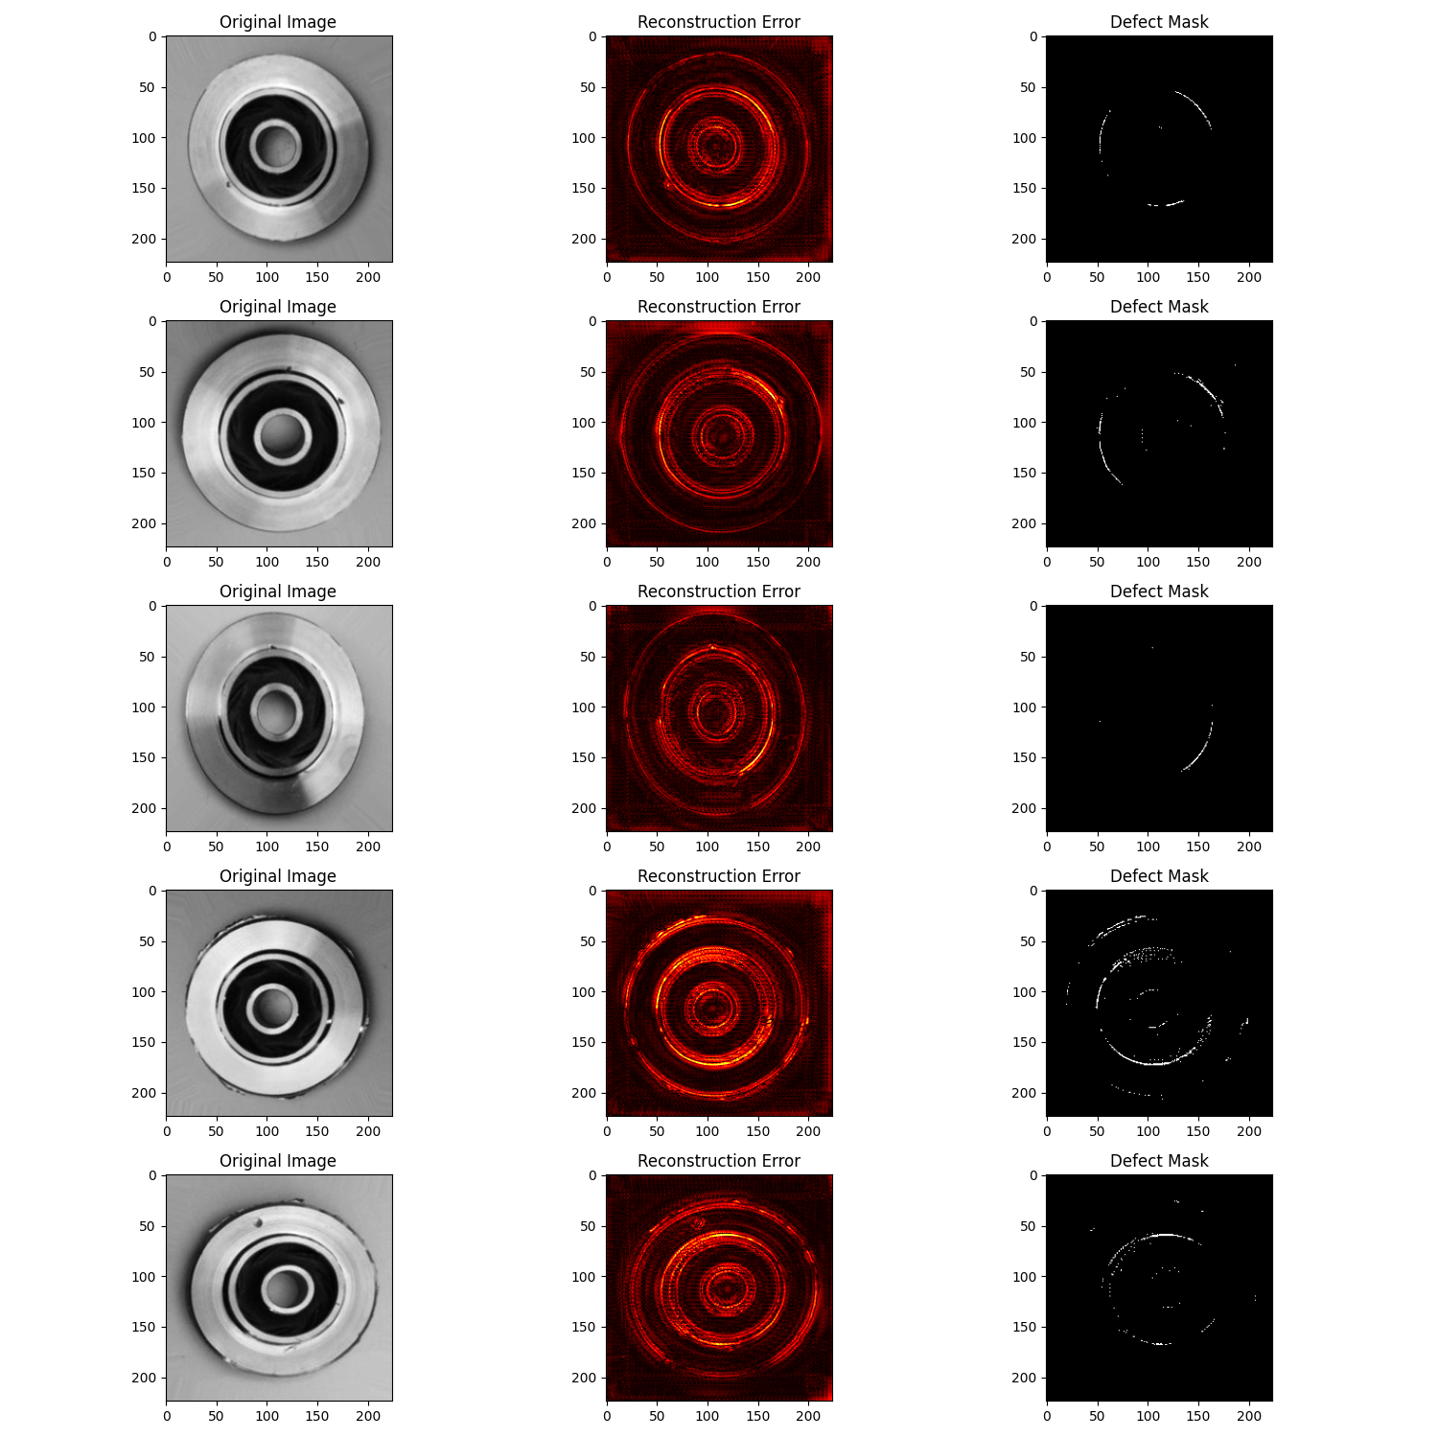
Reconstruction_Error:
Abs( input - output )
Defect_Mask:
Reconstruction_Error > threshold (0.3)
Attention CAE

Slide 14
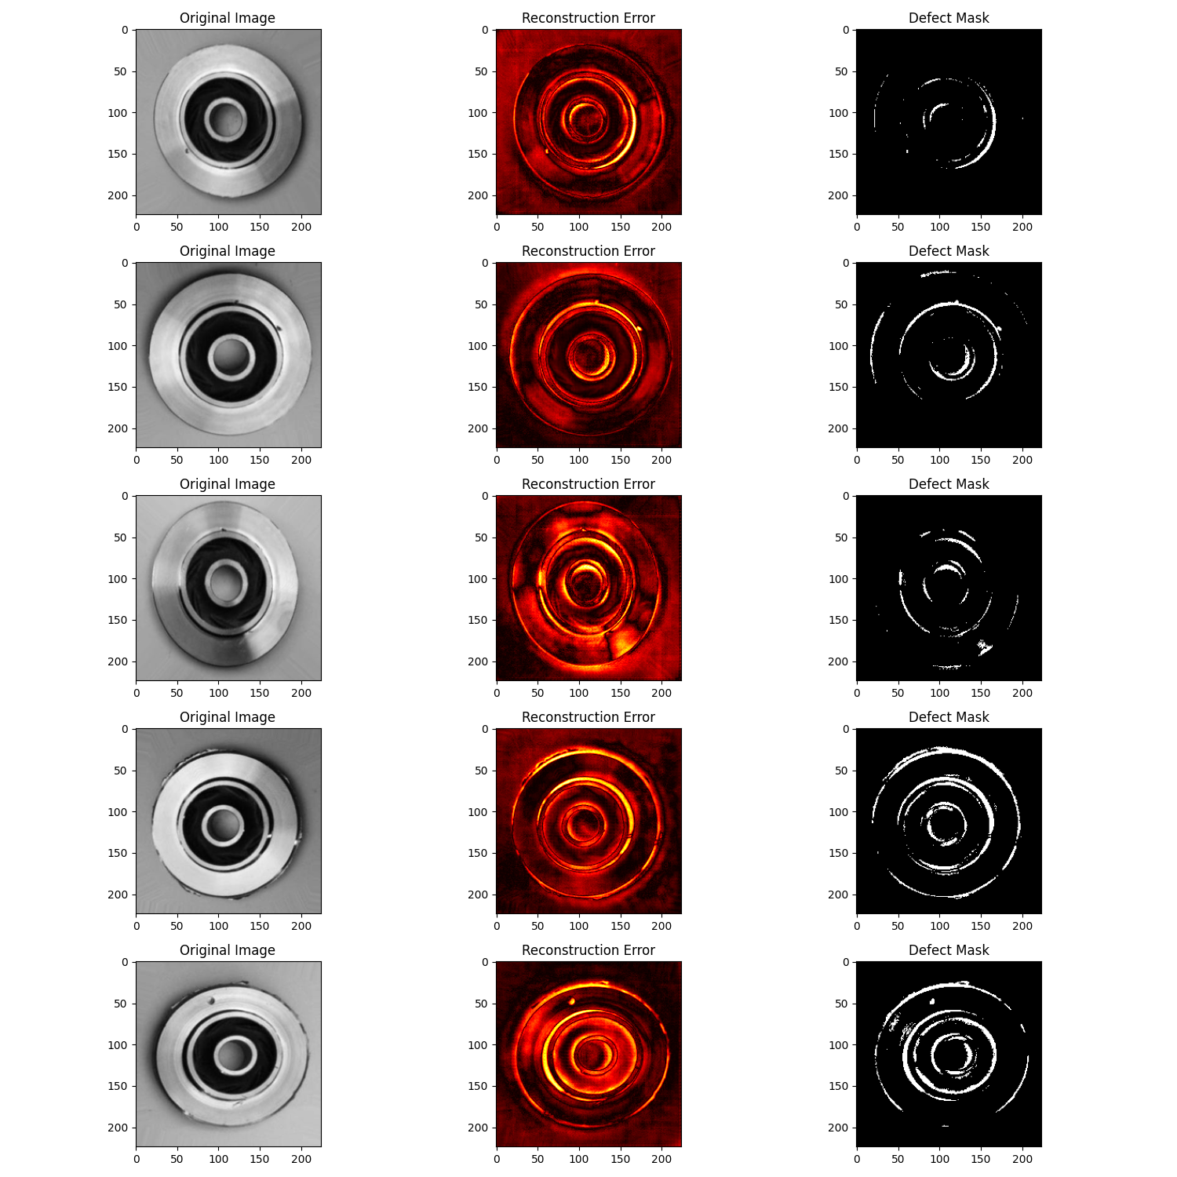
Reconstruction_Error:
Abs( input - output )
Defect_Mask:
Reconstruction_Error > threshold (0.3)
VAE

